Slide 1
Welcome to our presentation
)

Slide 2
Presented by
Hasanul Islam Rubel – 110221
Md. Al Mamun – 110237
Mahfuzur Rahman Khan – 110244
Ajay Kumar Yadav – 110253

Slide 3
Supervisor
SK Alamgir Hossain sir
Assistant Professore,
Computer Science and Engineering Discipline,
Khulna University,
Khulna-9208.

Slide 4
outlines
1.Name Of The Project
2.Introduction
3.Project Goal
4.Features
5.Discussion With Snapshots
6.Future Implementations

Slide 5
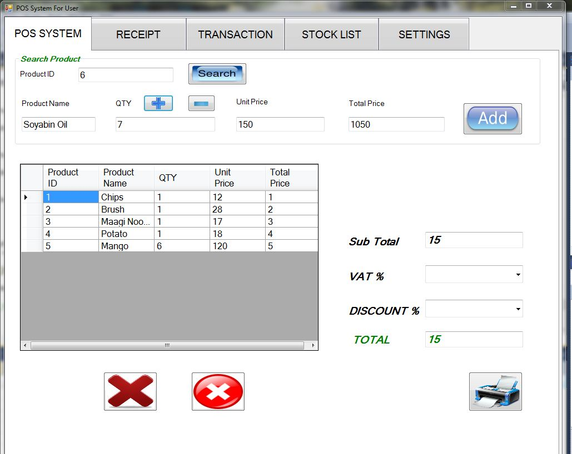
Project name
Point of Sale(POS)

Slide 6
What is POS ????
POS or PoS is an abbreviation for Point of Sale (or Point-of-Sale, or Point of Service) where you take money from the customer in exchange for goods or services that means it is a Departmental Store.
The main function of our point of sale system is to automate the sales process and keep a detailed history of all transactions.

Slide 7
Project goals
Learn how to write application in C#.NET
Learn how to create Graphics User Interface(GUI)
Learn how to implement Software using GUI
Learning about Database Management System

Slide 8
Features
Security
Unlimited Database
Time Consuming
Transaction List
Stock List
Add Products
Update Products
Delete Products
Login
Logout

Slide 9
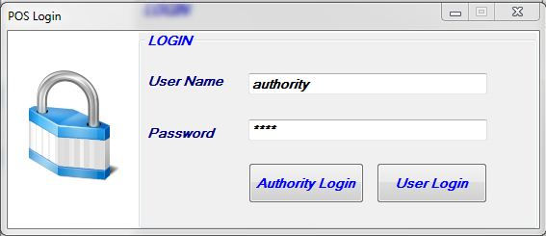
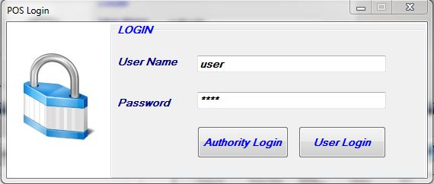
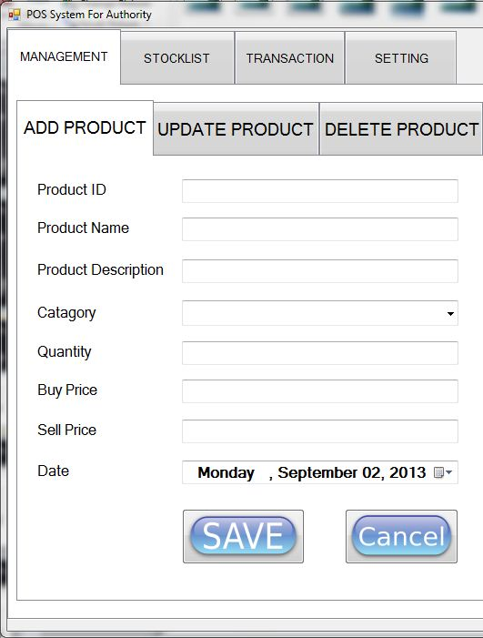
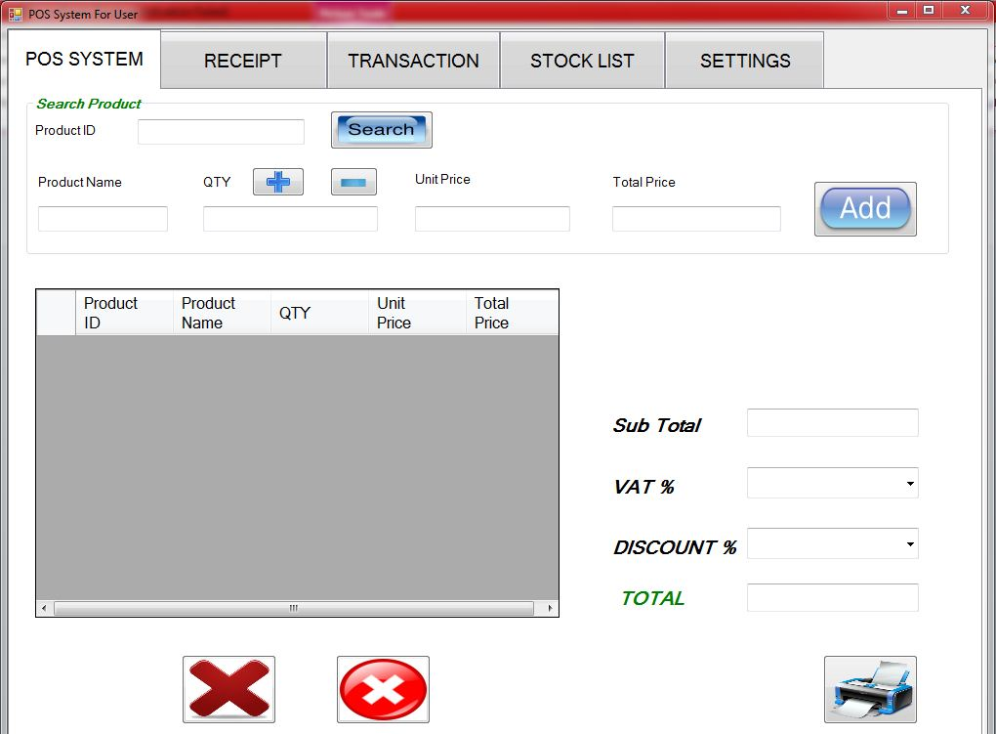
Login

Slide 10
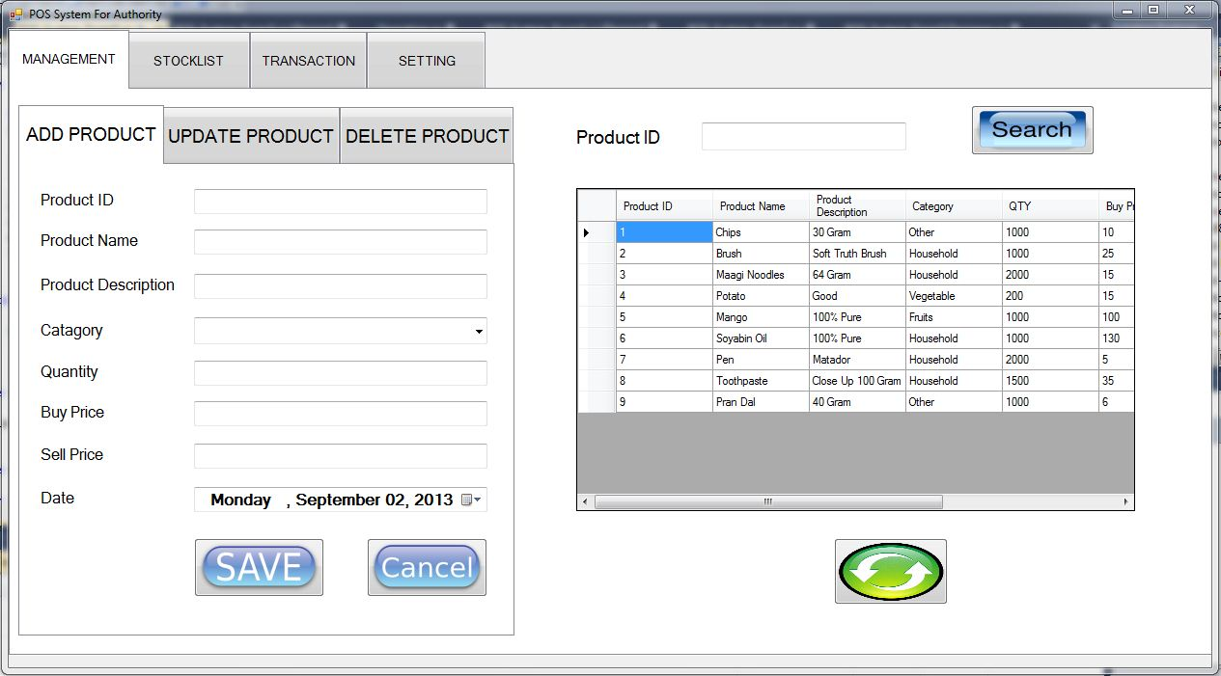
Pos system for authority

Slide 11
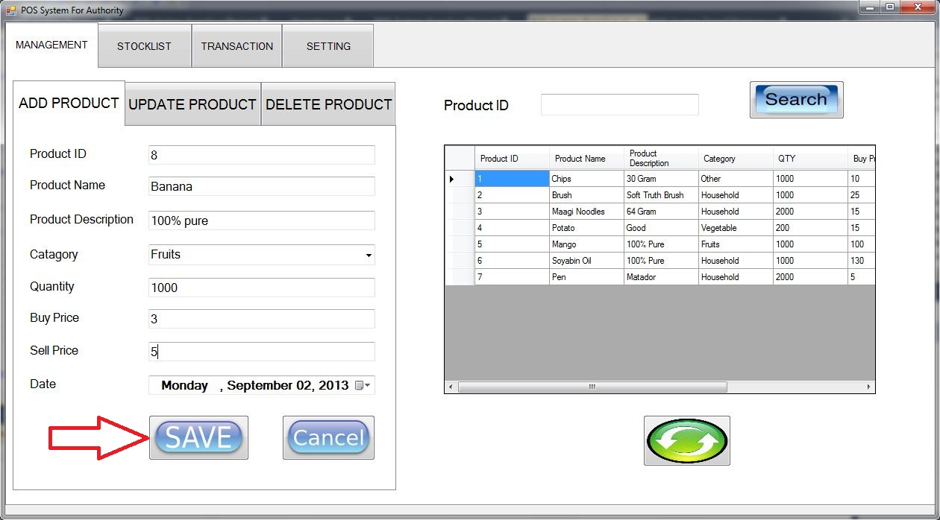
Add product

Slide 12
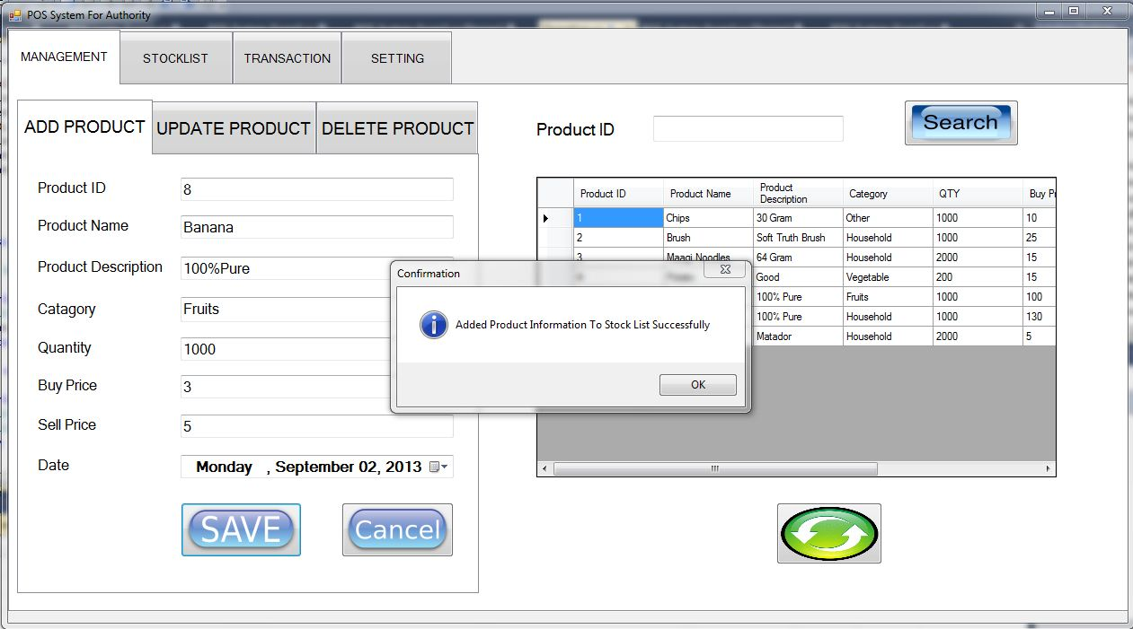
Add product

Slide 13
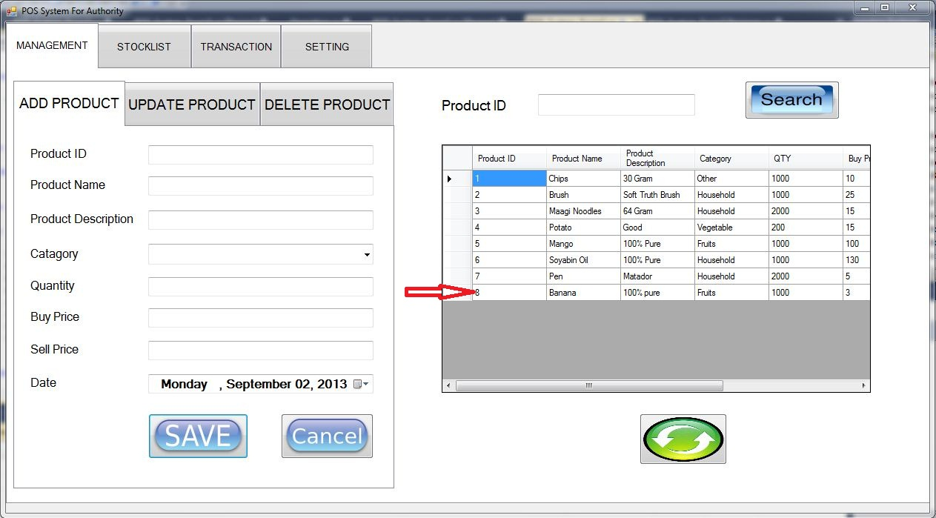
Add Product

Slide 14
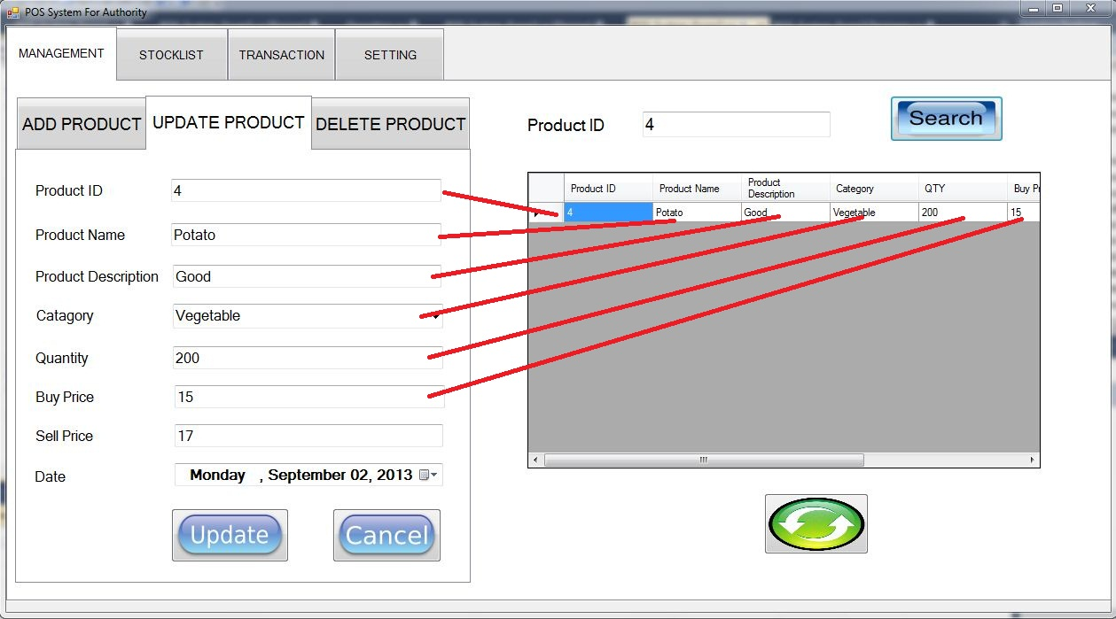
Update product

Slide 15
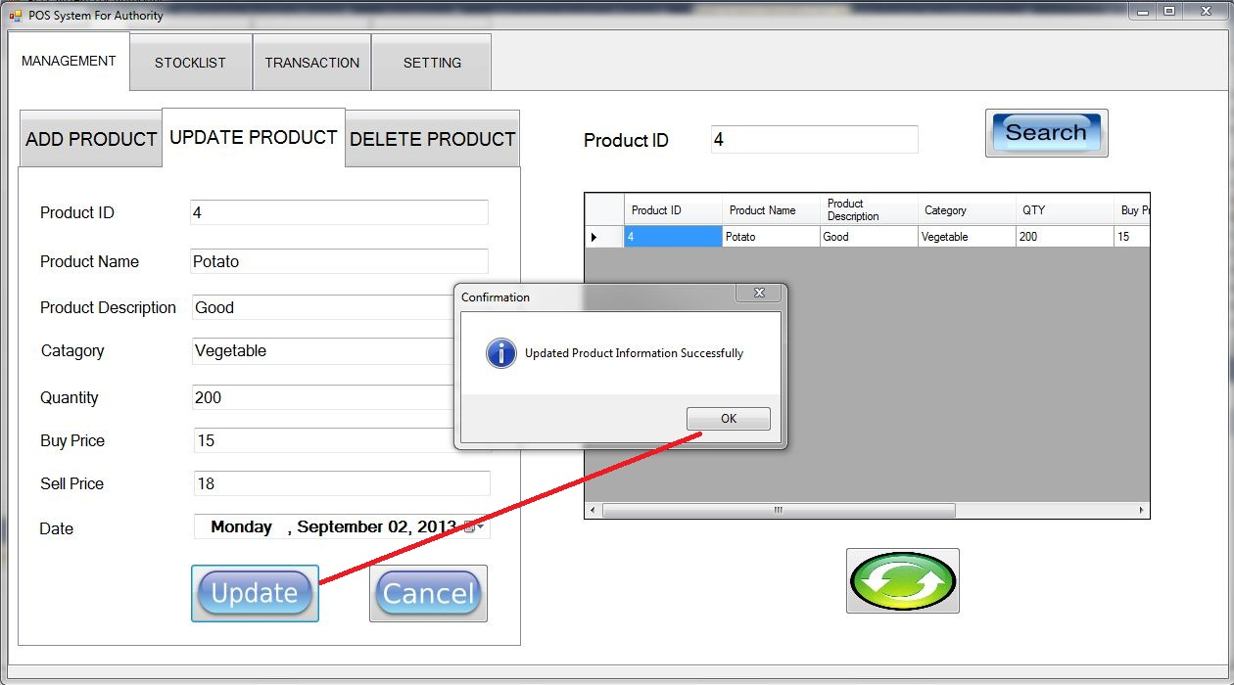
Update product

Slide 16
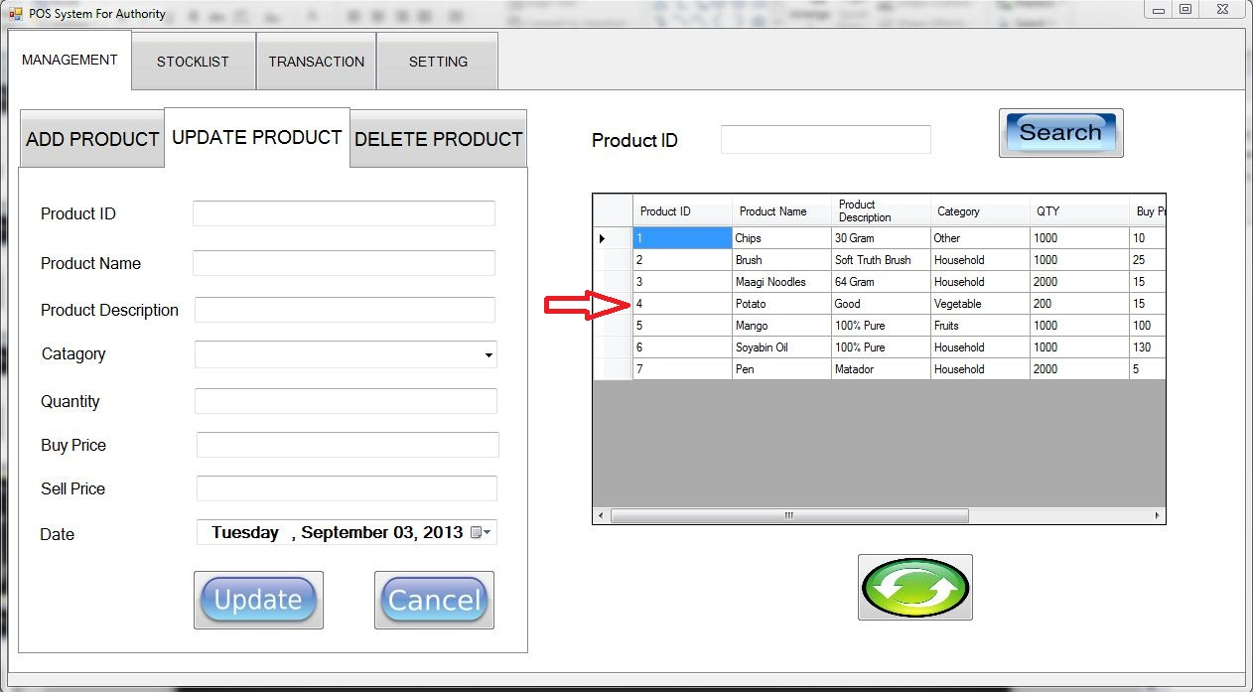
Update product

Slide 17
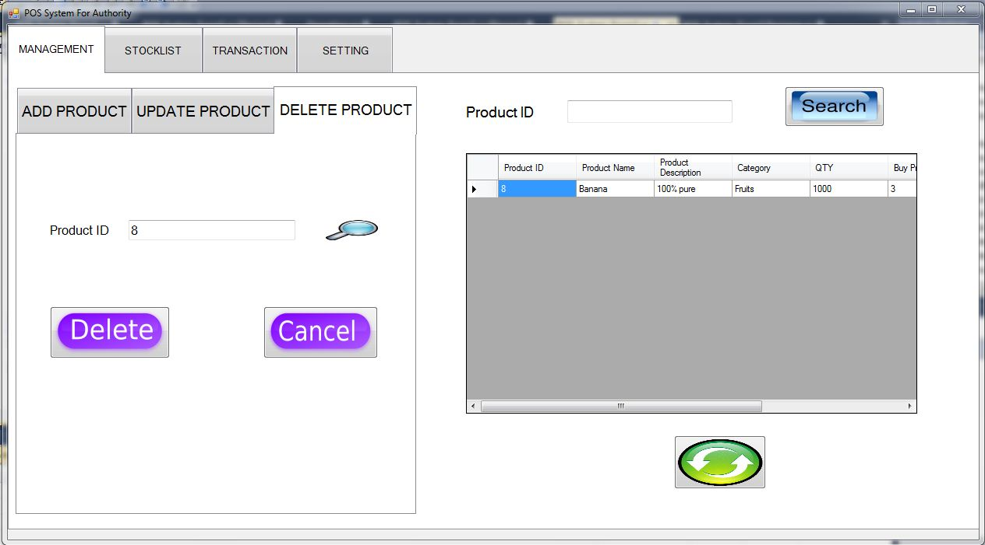
delete product

Slide 18
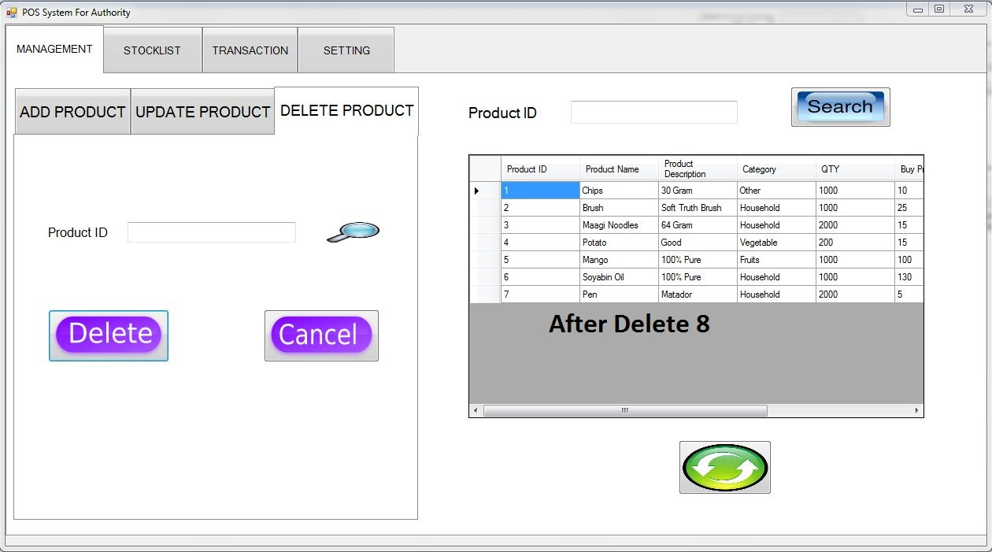
delete product

Slide 19
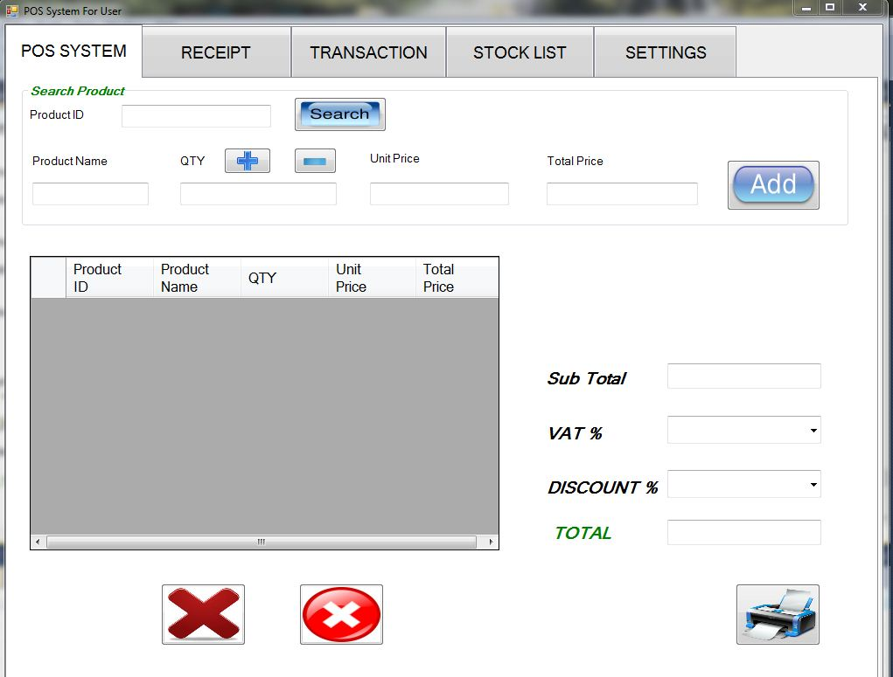
Pos system for user

Slide 20
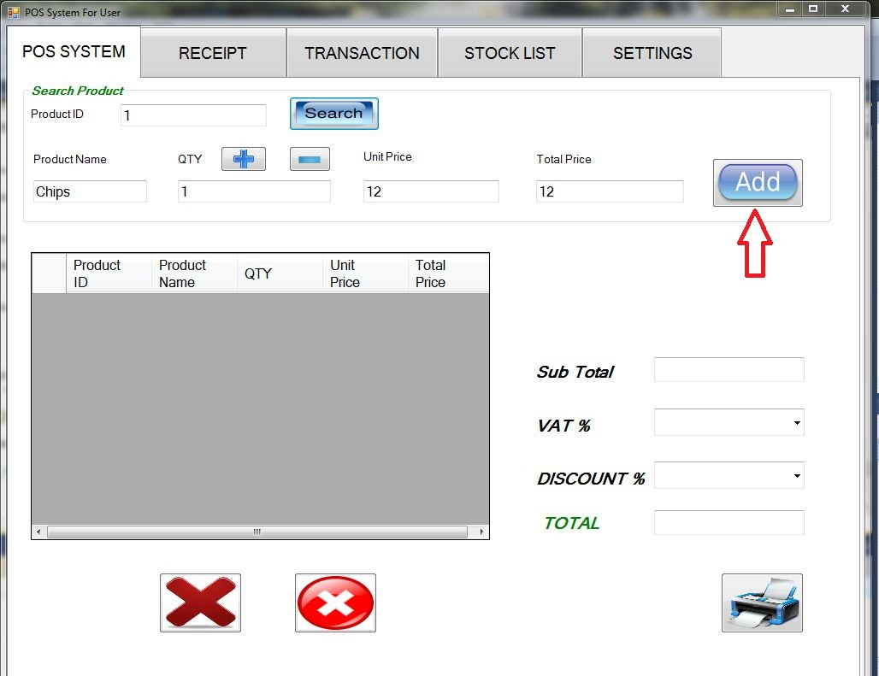
Pos system

Slide 21
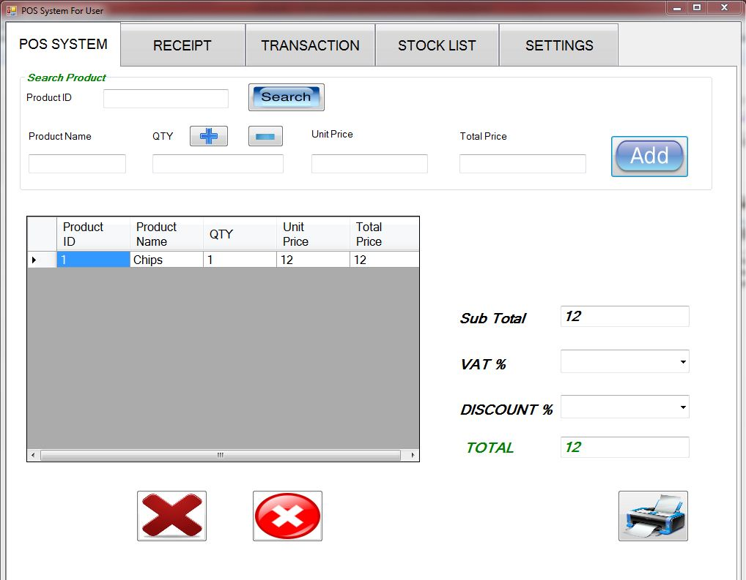
Pos system

Slide 22
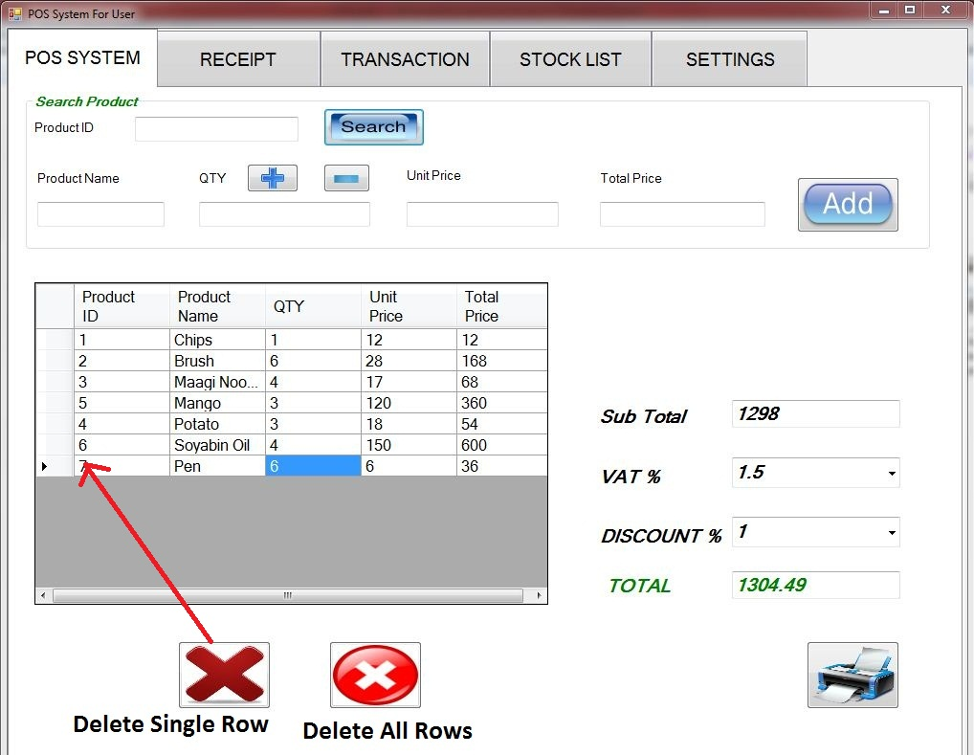
Pos system

Slide 23
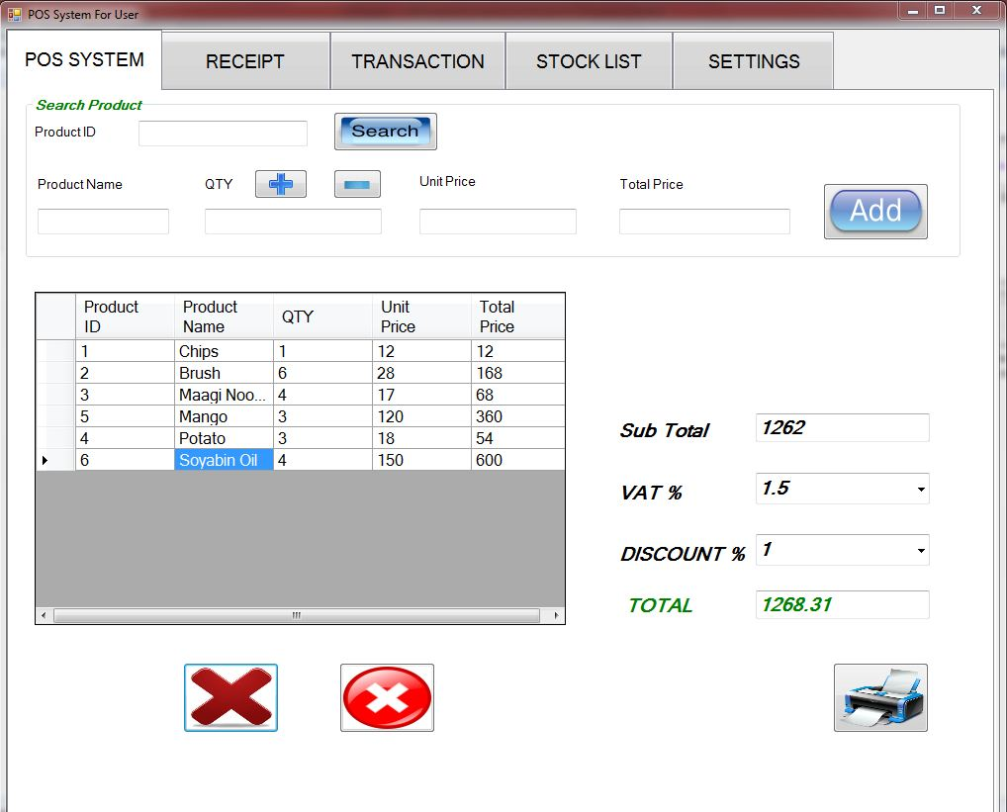
Pos system

Slide 24
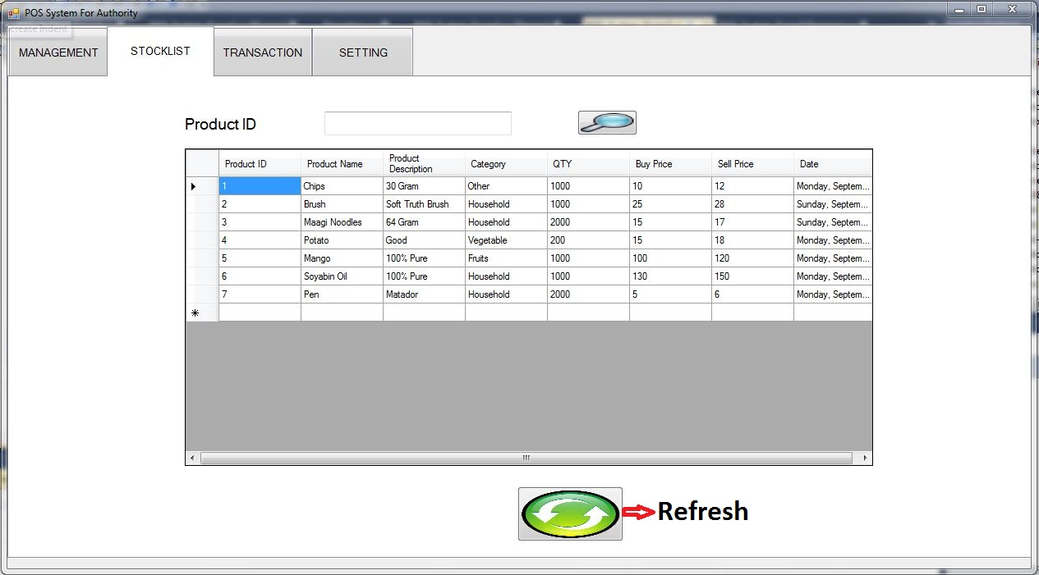
Stock list

Slide 25
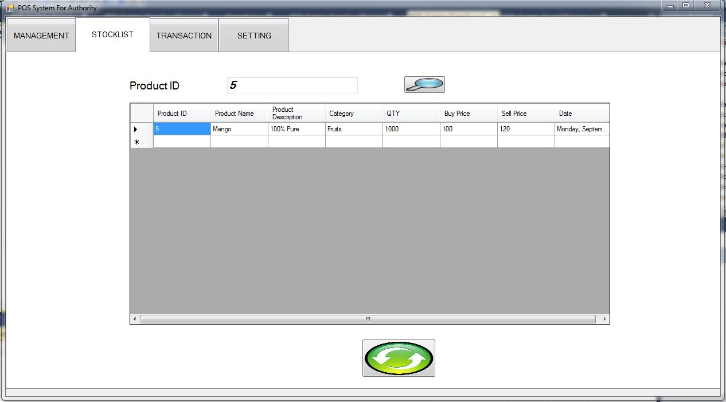
Stock list

Slide 26
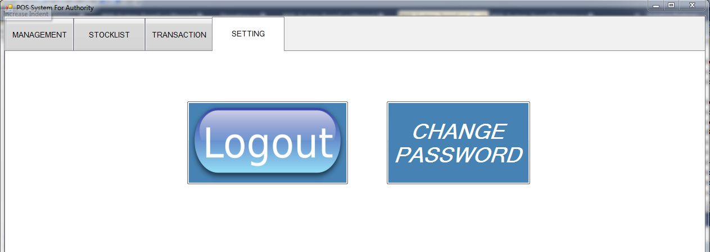
Settings

Slide 27
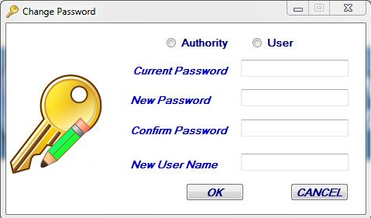
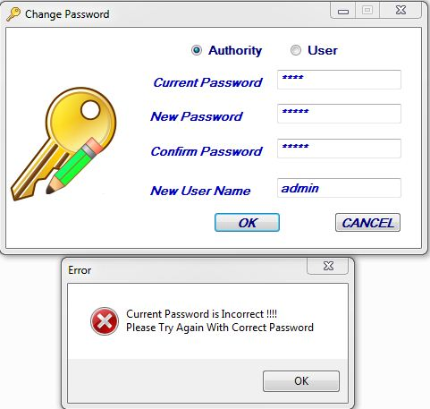
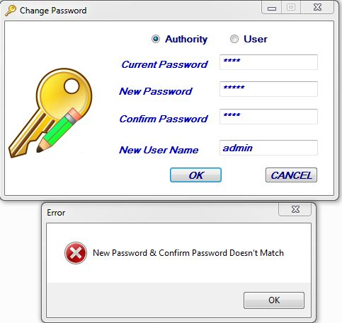
Change password

Slide 28
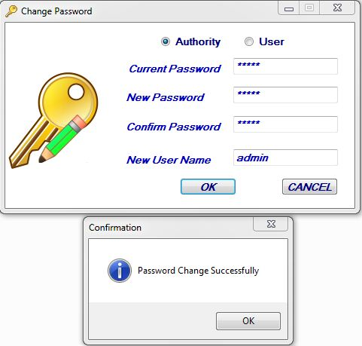
Change password

Slide 29
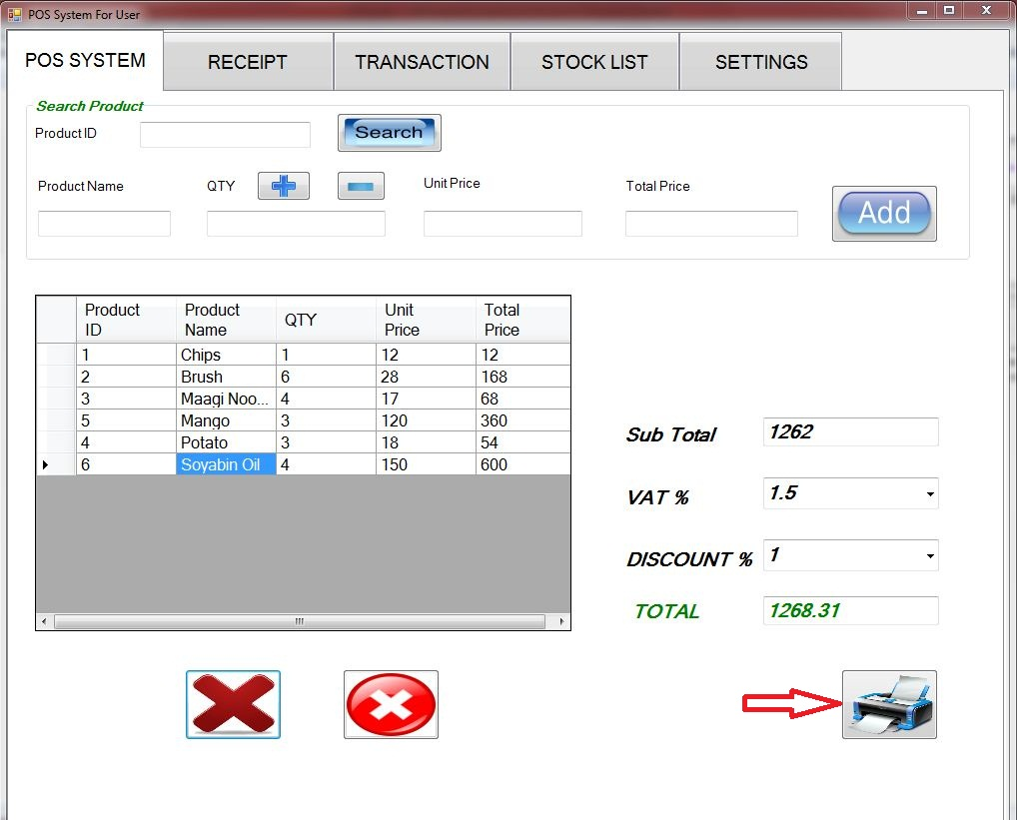
Pos system

Slide 30
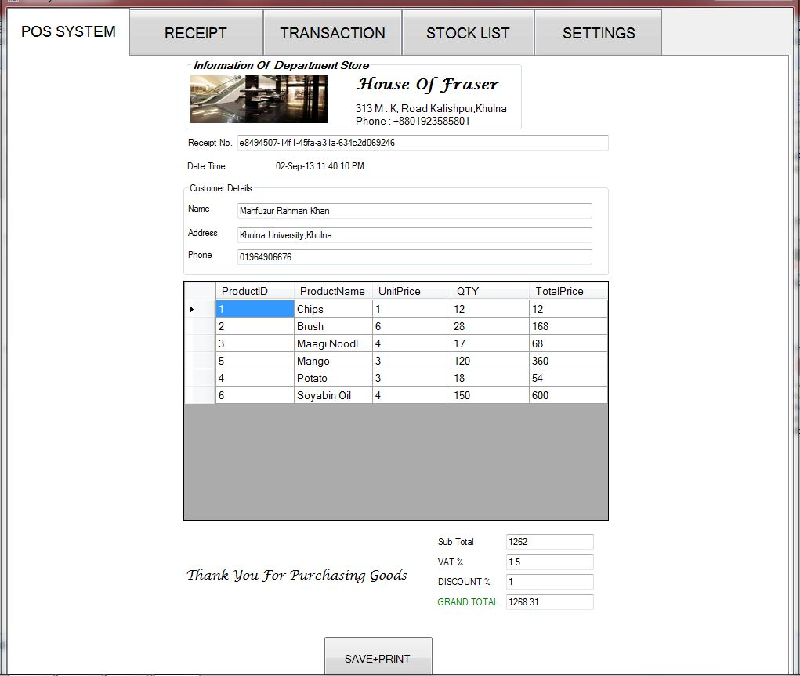
Pos system

Slide 31
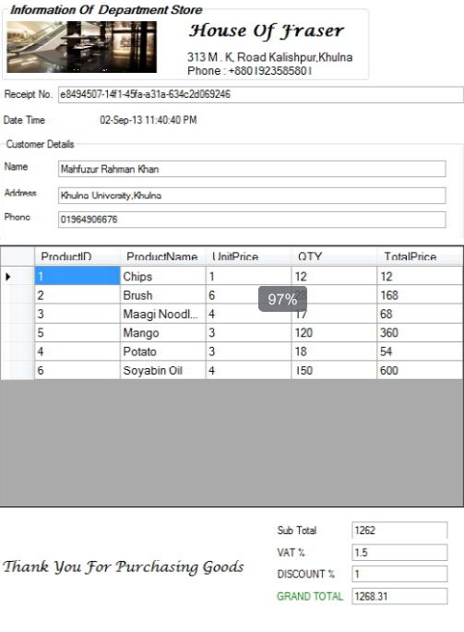
Pos system

Slide 32
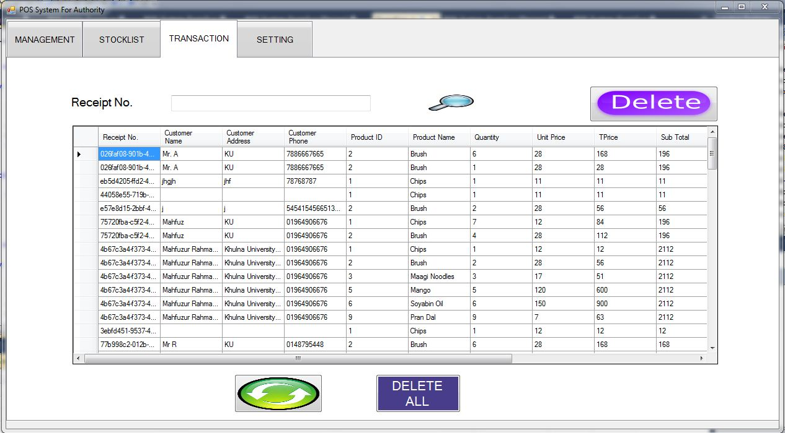
Transaction List For authority

Slide 33
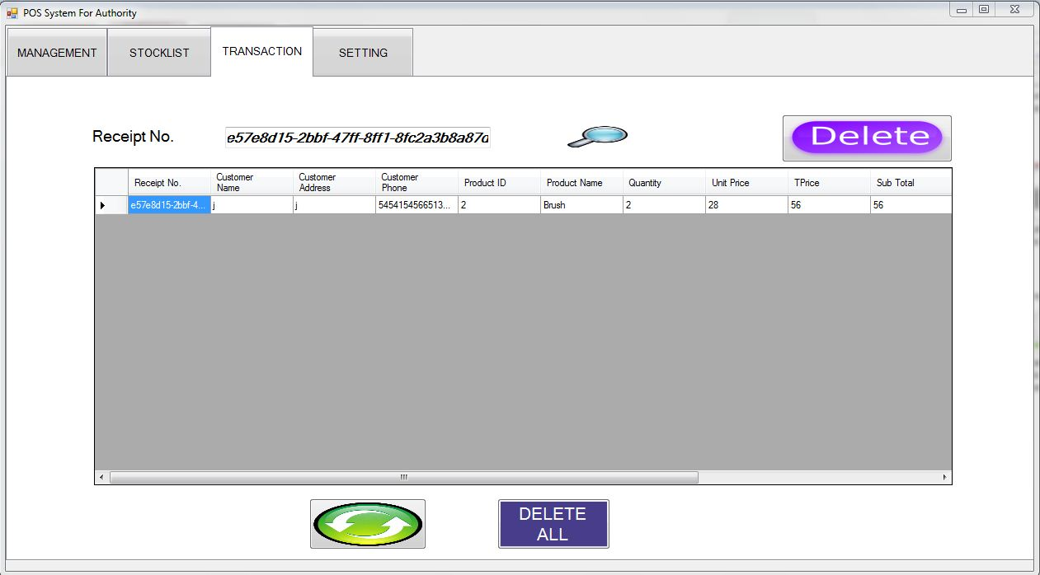
Transaction List For authority

Slide 34
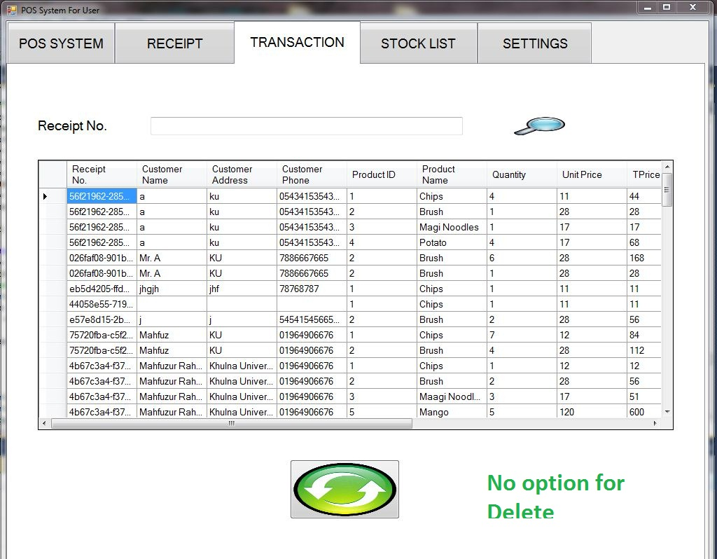
Transaction List For user

Slide 35
Future implementations
We want to sell our POS Software in any renowned Departmental Store.
We wish we will be updated our POS Software Internet Base and Sell it Online.

Slide 36
Special Thanks for
Amit Kumar Mondal sir
Lecturer,
Computer Science and Engineering Discipline,
Khulna University,
Khulna-9208.

Slide 37

Notes:
Do you have any Question ?????

